Slide 1


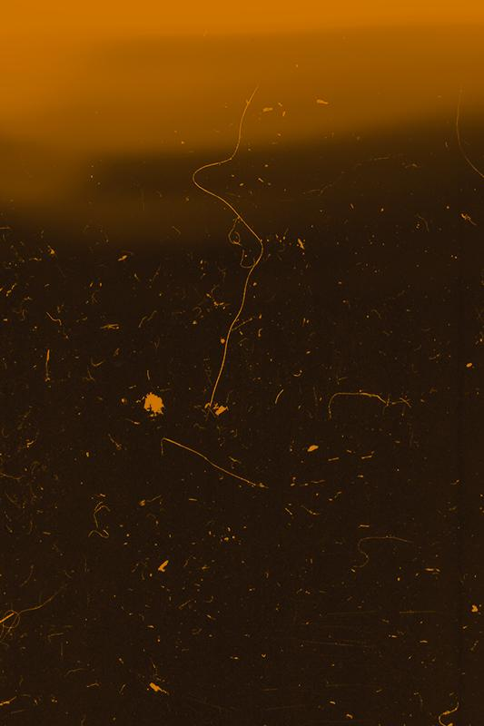
Final Ethical Presentation
ANTLIA
1998
ORION
Ryan J. Skelly
Week 13
1998

Slide 2
Presentation Overview
Summary of SpaceX
Ethical Issues of Space-Travel
Examples of How Space is evolving/will evolve
Applicable Ethical Theories
Solutions to Issues Faced
In Conclusion ...

Slide 3
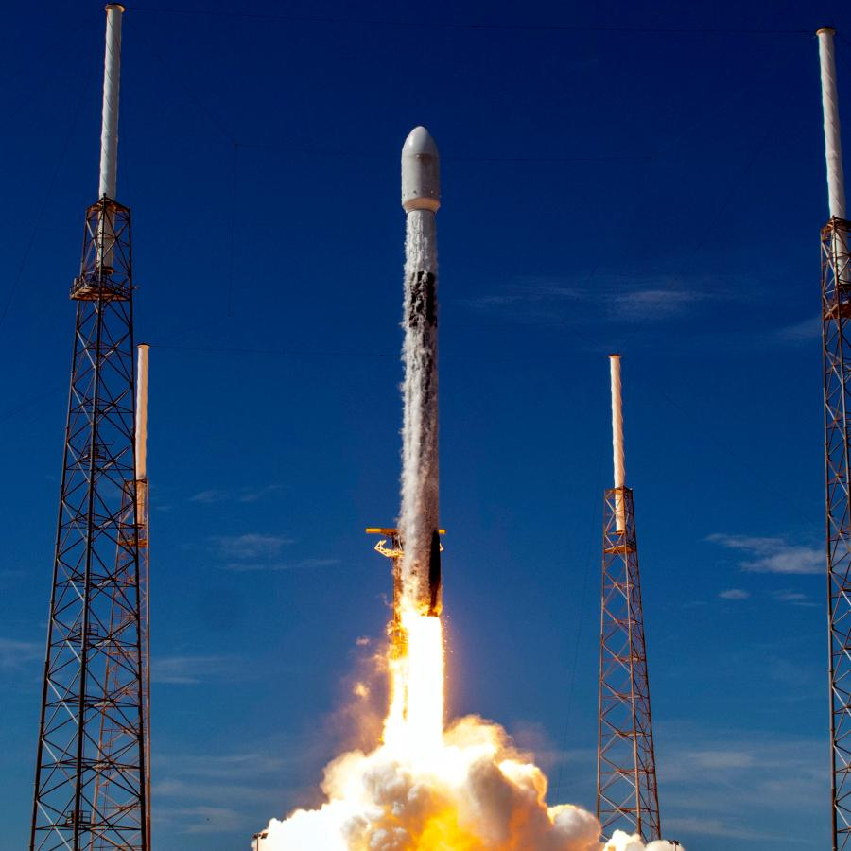
1.
SpaceX Review
The who, what, when, where, and why?(as previously discussed)

Slide 4
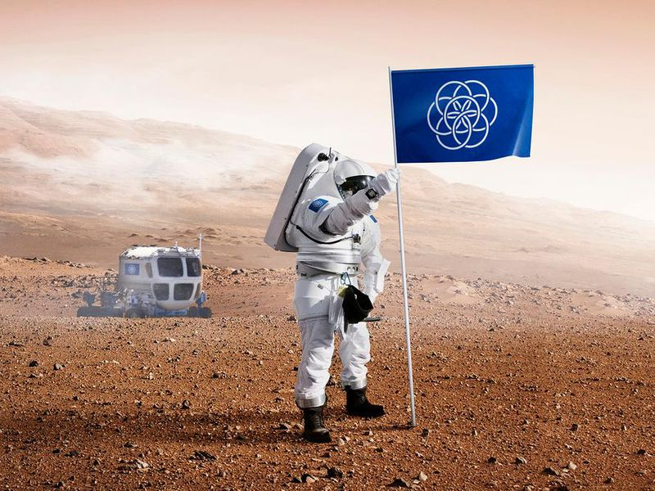
2. Ethical Issues of Space-Travel
Bioethical Concerns
Political Concerns
Failure

Slide 5
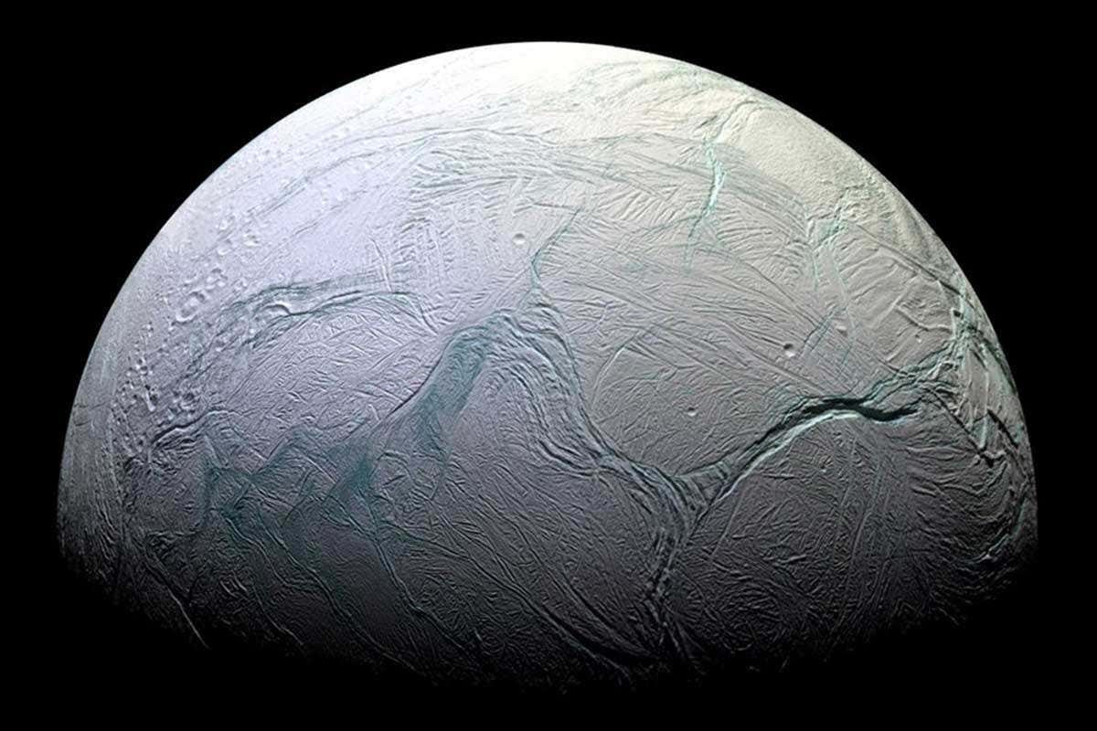

3a. Contamination / Infection?
Columbus
Intrusion of Alien life
Humans = Mold
Visa Versa
Saturn’s Moon, Enceladus

Slide 6
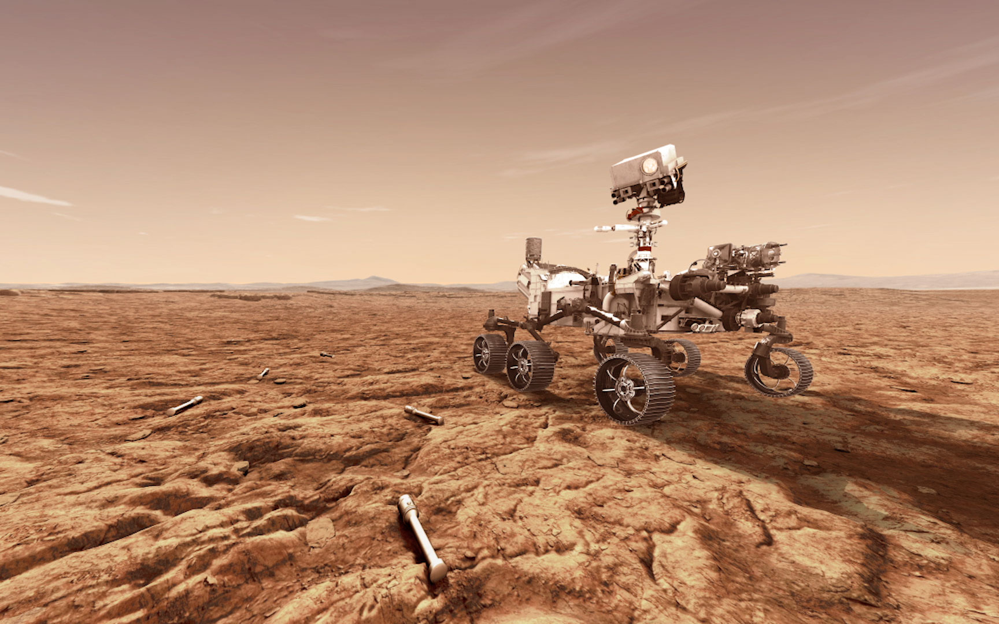
3b. Who owns Space?
Land
Property
Legal Jurisdiction
The “New” American Revolution

Slide 7
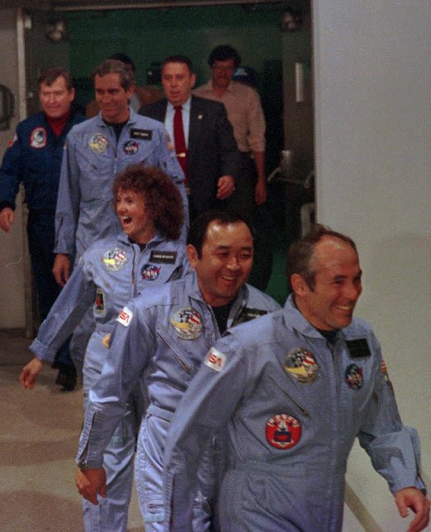
3c. Failure and Tragedy
Death
Responiblity
Challenger

Slide 8
4. Applicable Ethical Theories
Utilitarianism
Ethics of Care
Egoism
Natural Law & Deontology
Social Contract
Expansion benefits all, otherwise Overpopulation
Care of our Planet, our people, and other planets
New Frontier, Valuable Resources
Humans need to fight global warming
New form of governments need creation

Slide 9
5. Solutions to Issues Discussed
Safety
Globalistic Ideology
Wait …
Both in traversal and construction.
Climate Change
Libertarian Governing
Great Filter
Theoretical

Slide 10
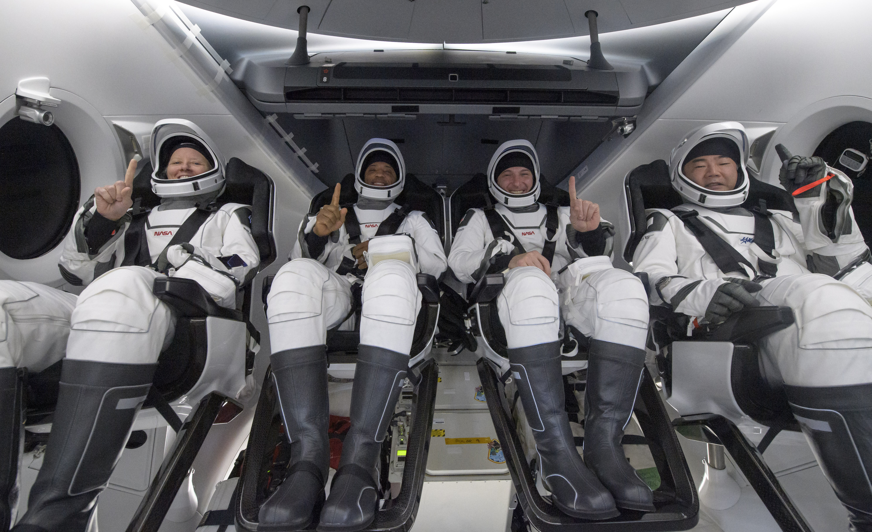
6. In Conclusion …
Space-Travel is far from our hands(In terms of personal spacecraft)
“Skill Ceiling”
Wednesday, May 5th 2021, Starship SN15 rocket

Slide 11
RESOURCES
https://www.spacex.com/
https://www.nasa.gov/press-release/as-artemis-moves-forward-nasa-picks-spacex-to-land-next-americans-on-moon
https://www.nasa.gov/press-release/crew-1-astronauts-safely-splash-down-after-space-station-mission
https://www.prindlepost.org/2018/02/spacex-ethics-space-travel/
https://www.slashgear.com/wp-content/uploads/2020/10/pia23492.jpg
https://theconversation.com/elon-musks-starship-may-be-more-moral-catastrophe-than-bold-step-in-space-exploration-124450
https://www.smithsonianmag.com/smart-news/does-planet-earth-need-its-own-flag-180955463
https://slidesgo.com/theme/astrophysics-lesson-for-college?login=qWDlpmAJcy4Bfn96

Slide 12
Thank You!! ☺
Any Questions?

